Slide 1



HMS Building Automation Solutions
KNX Dagerne hos Wexoe
2024-10-30
Stefan Stajkovic
Account Manager - Building Automation
Hardware Meets Softwar
e

Slide 2


Stefan Stajkovic
+10 years in automation Account manager at HMS

Slide 3

HVAC
Gateways
Network Gateways

Slide 4
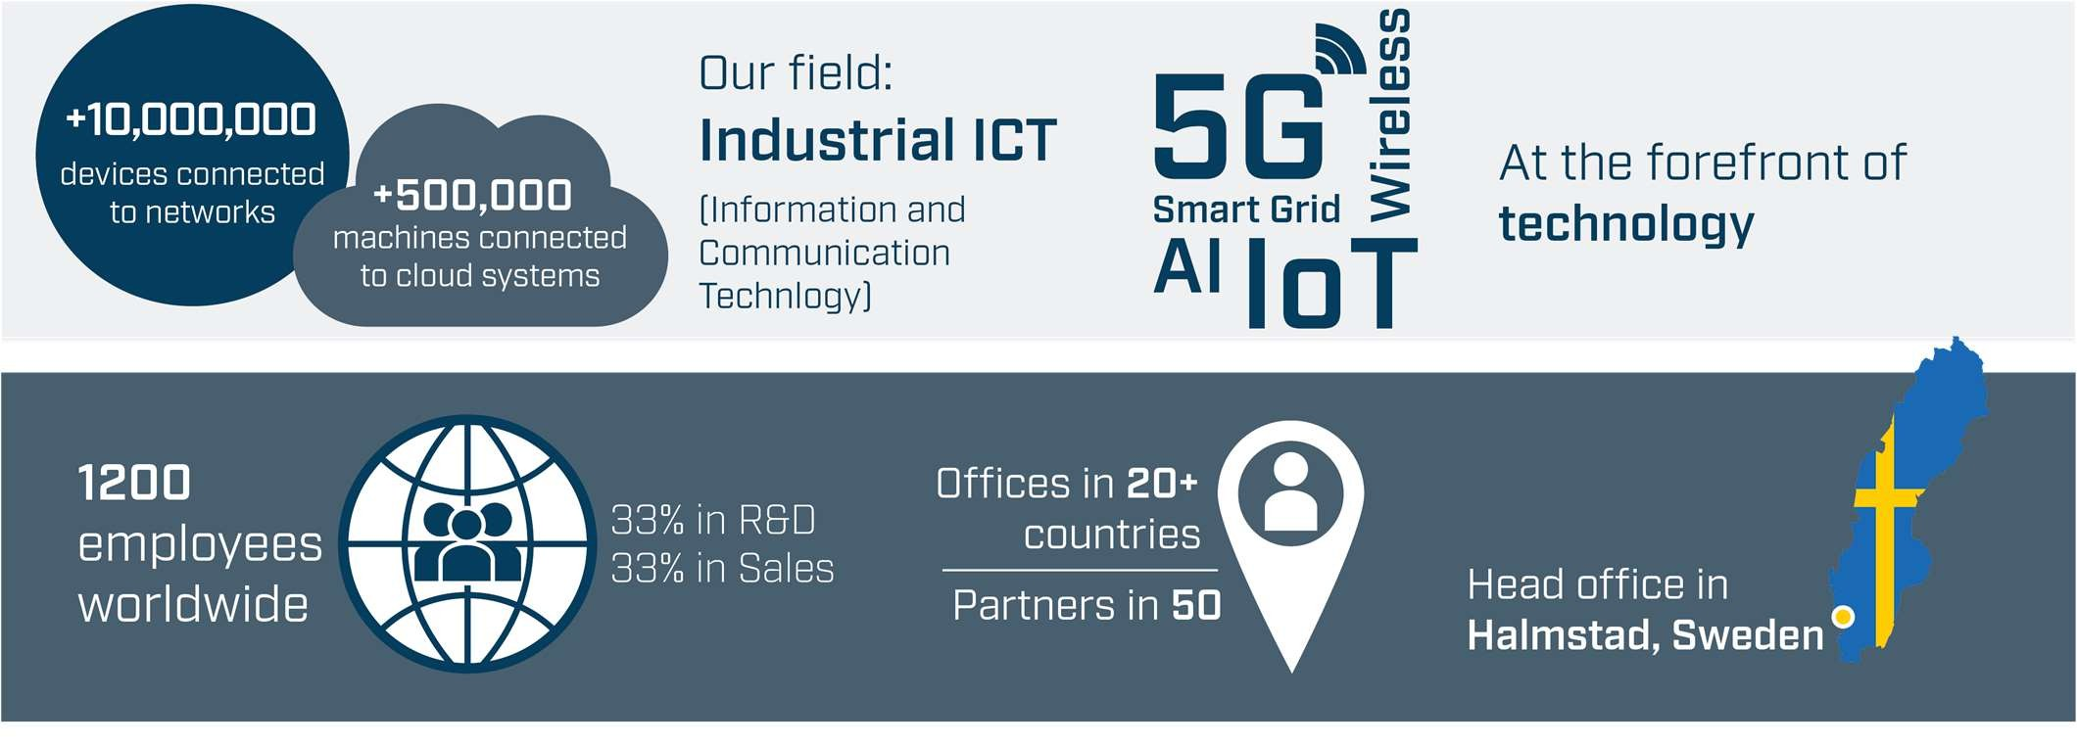
HMS at a glance

Slide 5


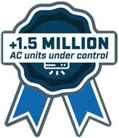
The Building Automation specialist within HMS

Slide 6
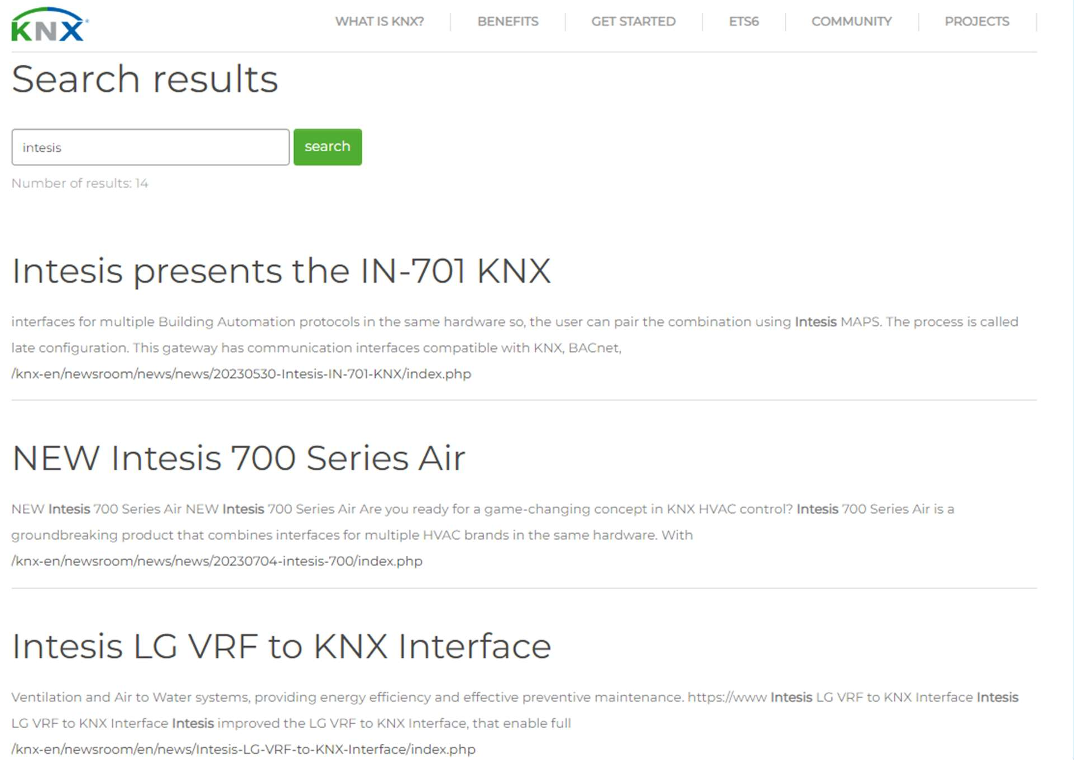

Slide 7
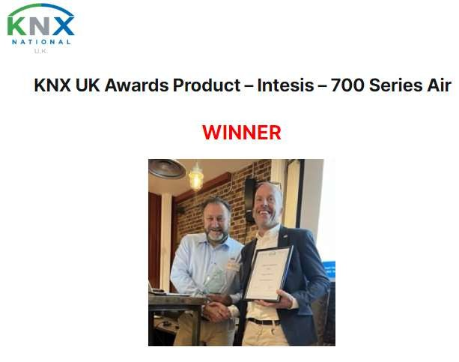
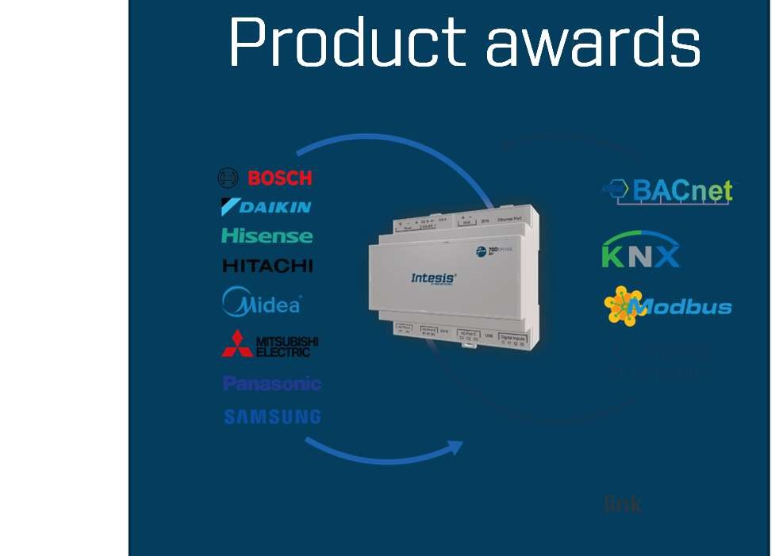

KNX UK
Product awards
link

Slide 8
BUILDING AUTOMATION – DIRECTION?

Slide 9





Protocols Everywhere
Energy Meters
AC, heating & Ventilation
Lights
EV Charging

Slide 10







Protocols Everywhere
30-40% of the world's energy consumption is attributed to buildings, this is the tools we use to make them more energy efficient.

Slide 11
INTESIS
HVAC Gateways

Slide 12

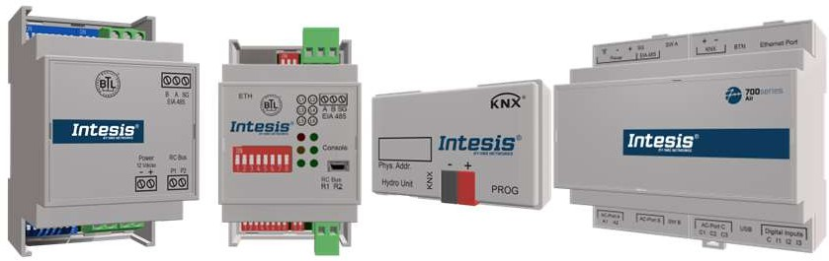




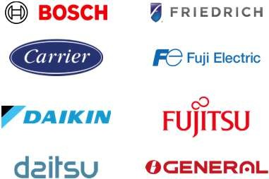


















The largest market range of gateways for HVAC integration
Developed in collaboration with leading HVAC manufacturers.
Bidirectional monitor and control of the AC system variables.
Solutions for any project size:
“1x1”: 1 gateway per AC unit
700series Air Multi-Indoor Units (MIU) gateways: use 1 centralized gateway connected to the outdoor unit to independently monitor and control multiple indoor units through control systems (KNX, Modbus, BACnet, and Ip-based Home Automation)
MIU License | Capacity | Example of target installations
XXS | Up to 4 indoor units | Convenience stores, retail, and residential.
Small | Up to 16 indoor units | Villas, offices, and data centers.
Medium | Up to 64 indoor units | Commercial, corporate, hospitals, and universities
Large | Up to 128 indoor units | Large-scale offices, residential, and industrial buildings
Advantages of using Intesis centralized MIU gateways:
Cost Efficiency: Save on products, cabling, and labor by integrating complex HVAC systems with just one gateway, without sacrificing individual control of indoor units. Perfect for both building and home automation management systems.
Time-Saving Configuration: The MAPS scanning feature drastically reduces setup time by automatically detecting connected units and their control signals.
One configuration tool: The powerful Intesis MAPS configuration and diagnostics tool simplifies the installation process. No need to master multiple tools—this single, powerful tool handles all MIU AC gateway order codes for your integration projects.
Enhanced Energy Management: The advanced Intesis Power Estimation Algorithm empowers you to optimize energy usage by identifying and managing the highest energy consumers within your building.

Slide 13
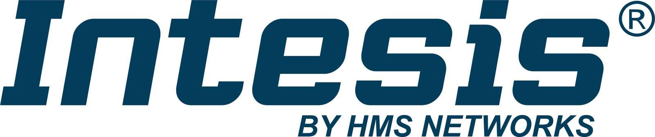



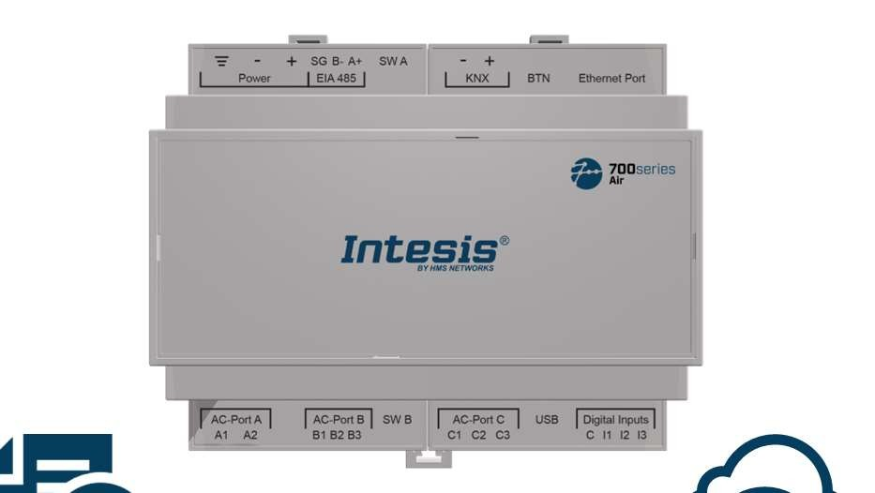


Fit your project size needs
Different capacity licenses available:
XXS, S, M, and L
Late Configuration
Keeping stock is now easier than ever! Each 700series Air order code allows you to configure the gateway to work with one of four building automation protocols. And in the case of the IN770 order codes, you also have the option to choose an AC brand from a selection of eight.
Scan feature Reduce the configuration time by scanning the bus to automatically detect the AC units connected to the system
3 Binary Inputs
Connect up to three energy pulse meters for Energy Saving purposes
Certifications International and local certifications. Ready for sales worldwide
IoT ready Ready for future cloud connectivity

Slide 14
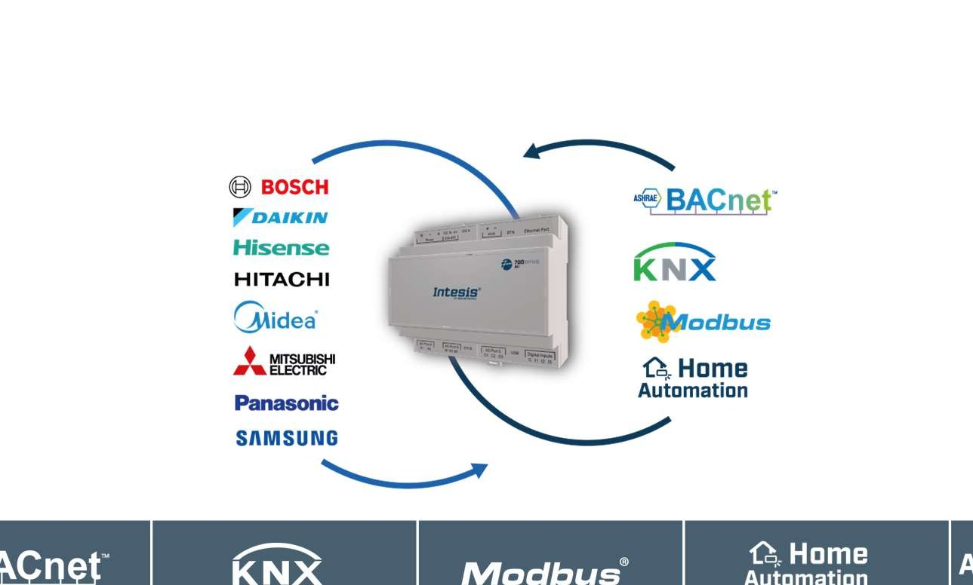







Multi-Indoor Units (MIU) AC gateways
Save time and money on cabling and installation costs by using a single gateway IN770 to monitor and control multiple indoor units individually.
The IN770AIR---O000 multi-indoor units (MIU) can be easily configured using Intesis MAPS for working with one of the eight AC brands and one of the specified building automation protocols.
Reduce configuration time by scanning the bus to automatically detect all the units connected to the VRF system, including their control signals.
Centralized solutions
Protocol
Connection
Depend on the AC Brand.
See Intesis manuals for additional information
IN770AIRXXSO000 IN770AIR00SO000 IN770AIR00MO000 IN771AIR00LO000
Commercial, VRV, VRF
XXS: up to 4 I.U. / 15 groups 00S: up to 16 I.U. / 50 groups 00M: up to 64 I.U. /100 groups 00L: up to 128 I.U
IN770AIRXXSO000 IN770AIR00SO000 IN770AIR00MO000 IN771AIR00LO000
Commercial, VRV, VRF
XXS: up to 4 I.U. / 15 groups 00S: up to 16 I.U. / 50 groups 00M: up to 64 I.U. /100 groups 00L: up to 128 I.U
IN770AIRXXSO000 IN770AIR00SO000 IN770AIR00MO000 IN771AIR00LO000
Commercial, VRV, VRF
XXS: up to 4 I.U. / 15 groups 00S: up to 16 I.U. / 50 groups 00M: up to 64 I.U. /100 groups 00L: up to 128 I.U
IN770AIRXXSO000 IN770AIR00SO000 IN770AIR00MO000 IN771AIR00LO000
Commercial, VRV, VRF
XXS: up to 4 I.U. / 15 groups 00S: up to 16 I.U. / 50 groups 00M: up to 64 I.U. /100 groups 00L: up to 128 I.U
-
I.U. = Indoor Units
Groups: this is only for Mit. Electric
The IN771 only works with Panasonic units

Slide 15
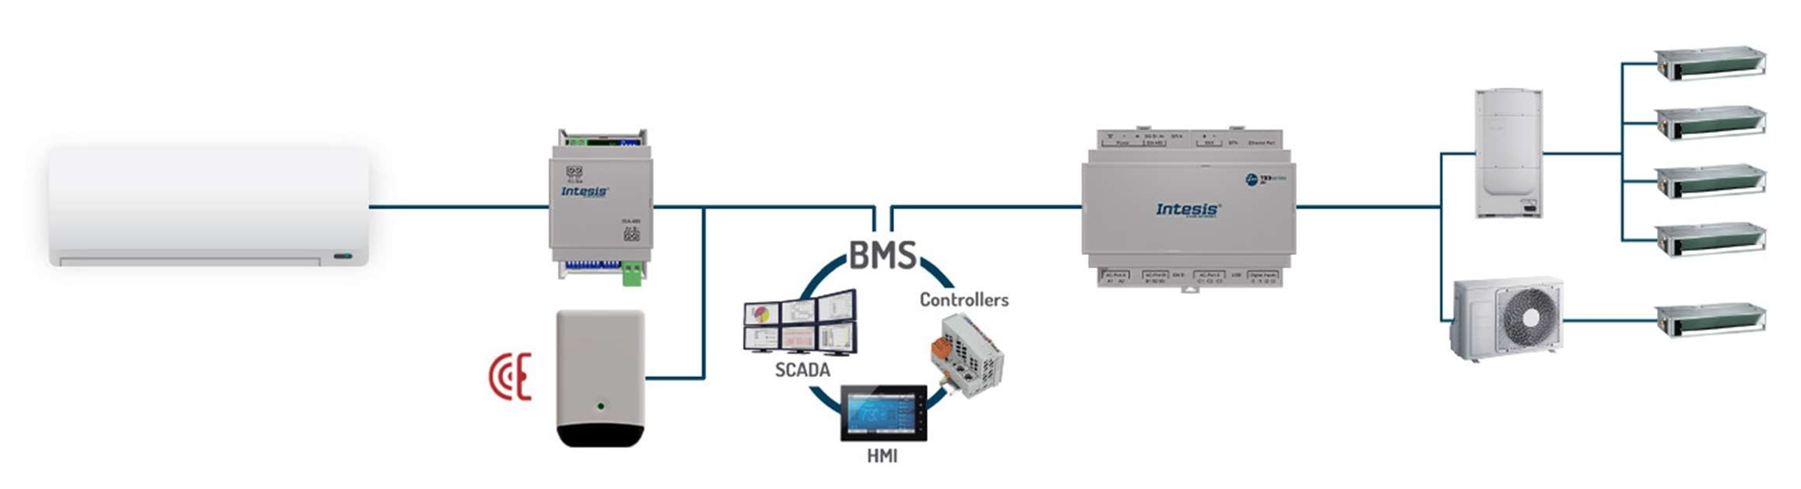

Connection with AC units
1x1 wire, IR & Multi Interface <–> BMS

Slide 16

– Our strengths
ENERGY EFFICIENCY | EASY TO USE
SCALABILITY | RELIABLE SOLUTIONS

Slide 17
Intesis Network Gateways

Slide 18
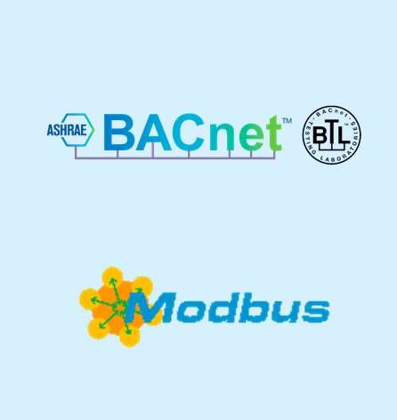











Protocols supported by Intesis Network Gateways
BMS/Scada/Controllers/HMI
Field Devices

Slide 19
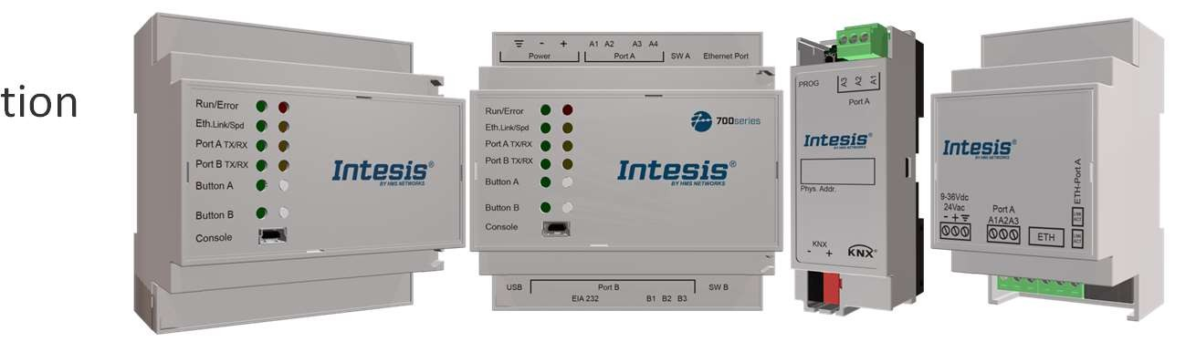


Intesis Network Gateways
We offer integration solutions for all your needs
Intesis supports all major building automation technologies and standards.
Simple, robust and reliable.
Configuration software providing an easy setup process, examples, templates and useful diagnostics and troubleshooting tools.
Certifications for protocols and markets.

Slide 20


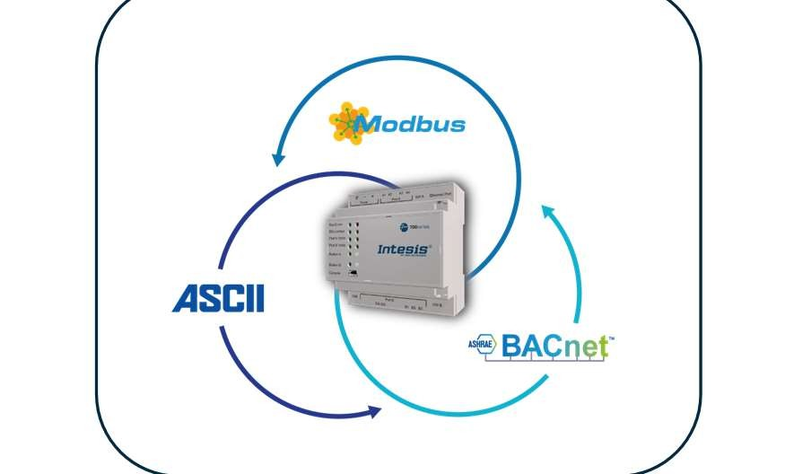




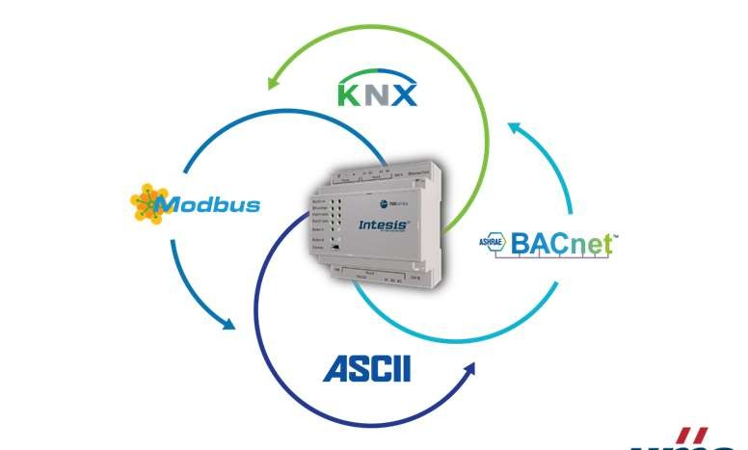

700 Series Intesis platforms for multi-protocol selection
Series IN700 - 485
Product features
700 Series is the new platform concept for Intesis
Protocol Translators.
Stock-Friendly
This concept enables interfaces for multiple Building Automation protocols in the same hardware.
Multiple protocol combinations for each hardware
Versatility
BENEFITS:
Flexible and agile protocol translation.
Reduced number of order codes to stock,
optimizing distributors lead times.
User-friendly configuration
“Late configuration”: using Intesis MAPS, the user can pair the protocol combination needed for the project.
Easy to setup with Intesis MAPS, our user-friendly configuration tool.
Series IN701 - KNX
The user can change applications quickly with our configuration tool Intesis MAPS.
High Capacity
Up to 3000 data points of capacity to match your Project needs.
Diagnostic and troubleshooting tools
available in our configuration tool MAPS
Certification
Minimize technical service requests.
International and local certifications. Ready to be sold worldwide.

Slide 21
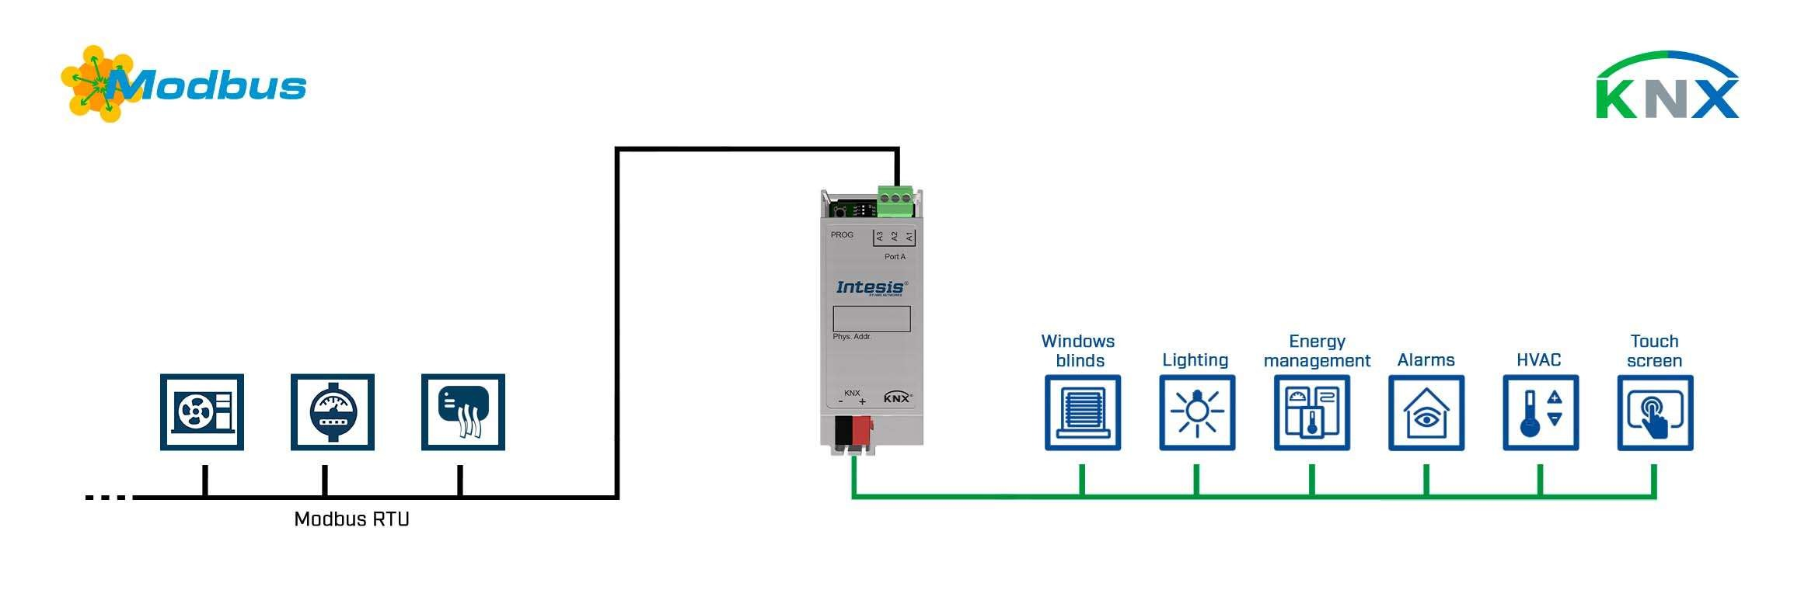
ONE BMS – MANY PROTOCOLS
Control Modbus devices from KNX, configure with ETS
Article number | Description
INKNXMBM1000200 | Modbus RTU Master to KNX TP Gateway - 100 points
HVAC
Meters
AIR Quality sensors

Slide 22

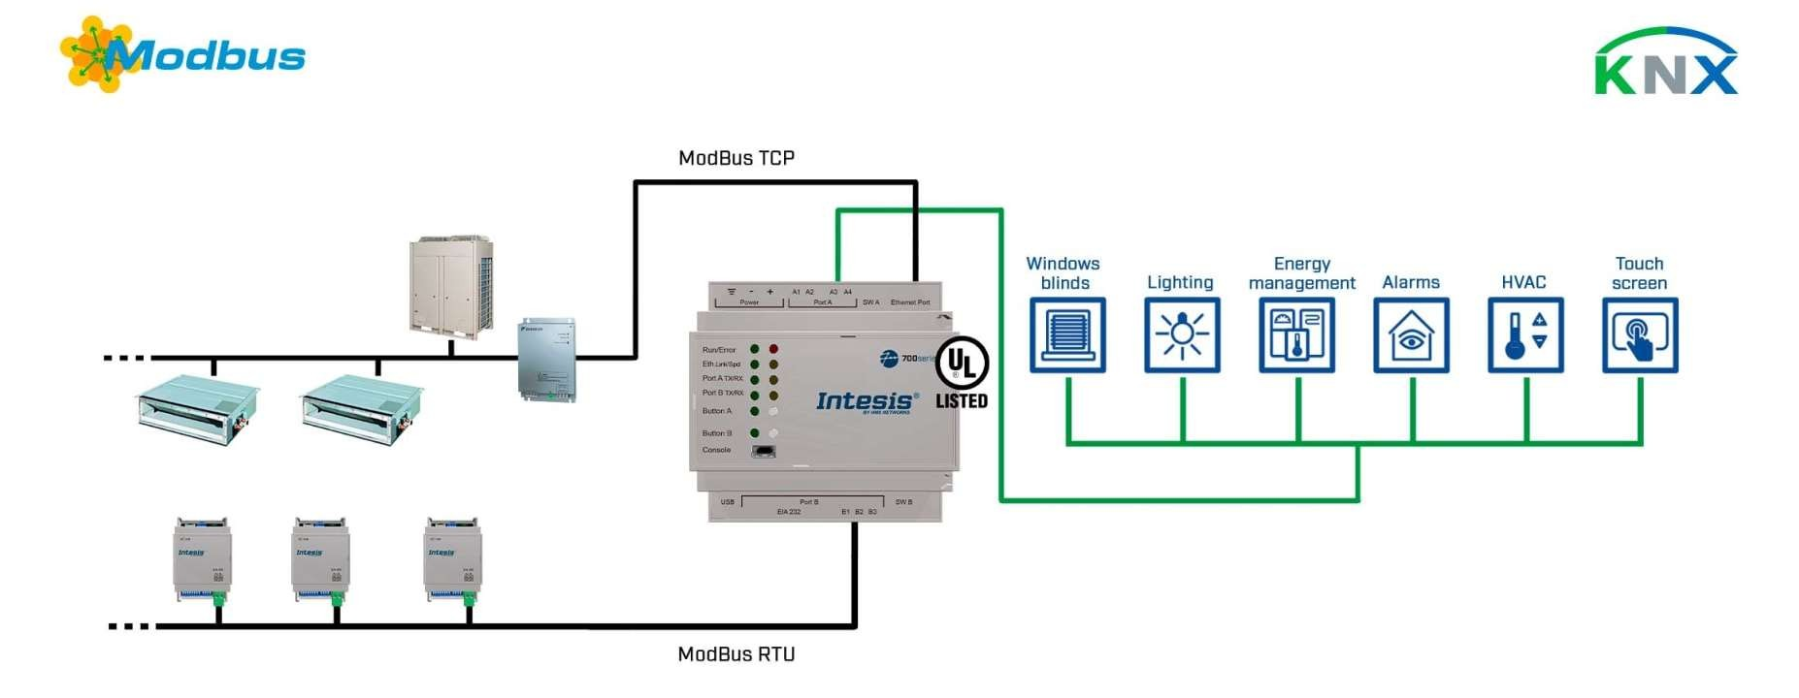
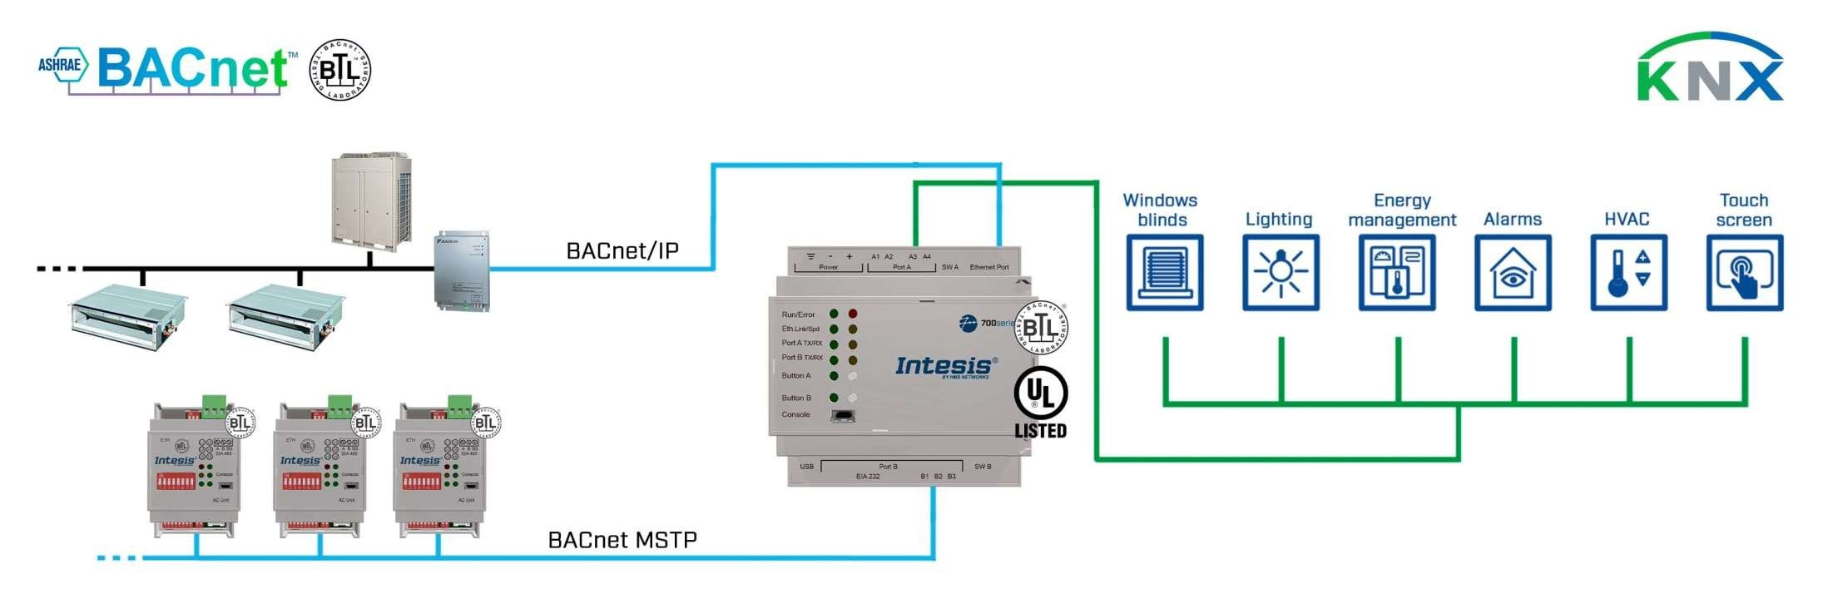
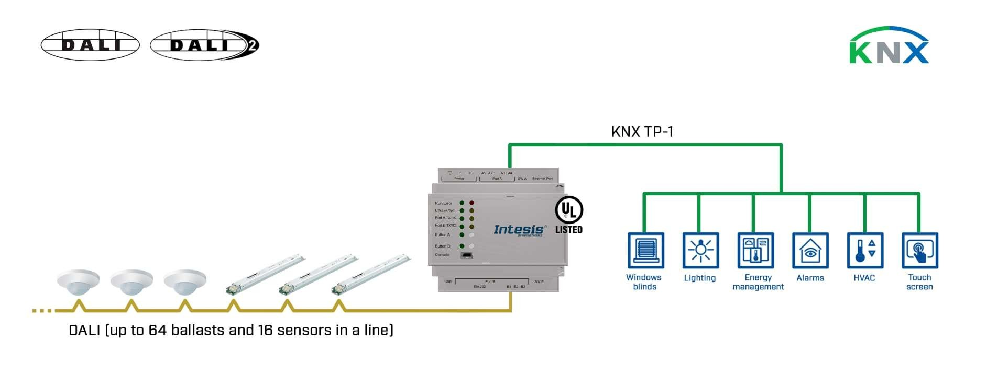
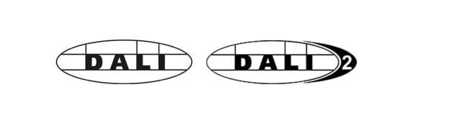
ONE BMS –
MANY PROTOCOLS
BMS only needs to support one protocol, our translators do the rest.
This solution is possible with Modbus, BACnet or KNX as your BMS protocol.

Slide 23
Intesis MAPS

Slide 24








For a fast and easy integration
Project templates
Provide a step-by-step configuration guide.
Scan function
Search and automatic import of Air Conditioning units.
Always up to date
Automation detection of new available versions.
Diagnostics
A powerful tool to diagnostic errors in installations.
Project recovery
Read out and recover the gateway configuration.
Multi-language
Available in 8 languages:
English, Japanese, Chinese, Spanish, Arabic, German, French, and Italian.
Secure configuration
Protected by password.

Slide 25


Summary
Intesis HVAC Gateways Connect any AC to any protocol
Intesis Network Gateway
Translate any building automation protocol
Intesis MAPS
Powerful configuration tool
Intesis supports all major building automation technologies and standards.

Slide 26

Questions?

Slide 27
Stefan Stajkovic Account Manager
Thank you!
stes@hms.se
+46 709 57 11 97

